Slide 1
Vermont’s Zero Energy Now Program
Energy Transformation for Existing Buildings
Better Buildings by Design Conference
February 2021

Slide 2





Notes:
ZEN has been designed and implemented as a partnership between EFG, NEEP and BPPA

Slide 3
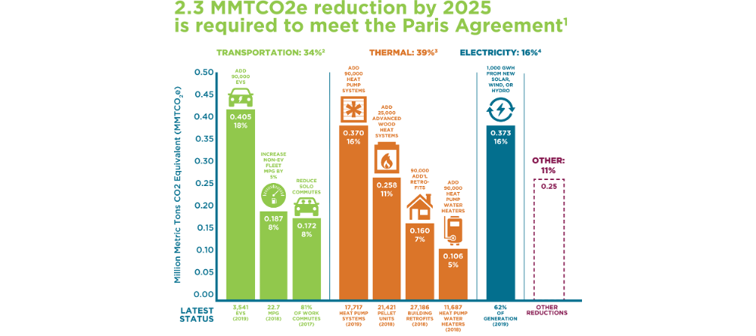
The Problem and the Opportunity in Vermont
Notes:
We have a lot of thermal and electricity measures to implement in order to meet our goals. ZEN is the one residential program that actually has the potential to help us meet these goals if fully implemented.

Slide 4
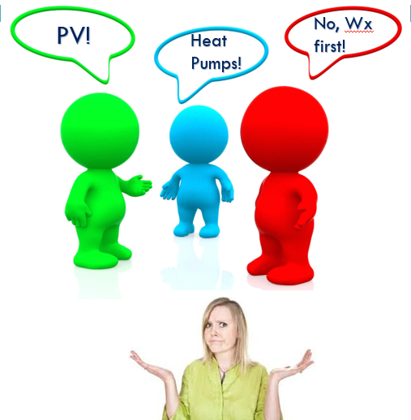
Customer Confusion…
Notes:
Besides our climate goals, we need to provide solutions to consumers that makes sense for them and their houses.

Slide 5

What is Zero Energy Now?
Notes:
-Developed by BPPA-VT. Highlight that this was INDUSTRY led – NOT utility. Their response to their business needs AND customer feedback.
-There are many entities and businesses involved to make this program a success.
The certified BPI professionals complete the energy analysis and weatherization work.
Secure your energy costs into the future by locking into more stable energy bills by using less and using local sources.
Realize all the available rebates – from Efficiency Vermont to Federal Tax Credits to the ADDITIONAL Zero Energy Now – hopefully for LMI customers from VLITE

Slide 6
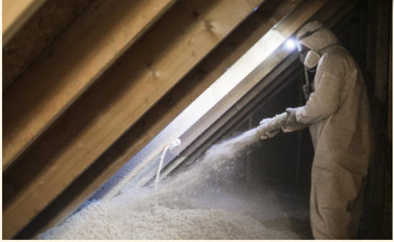

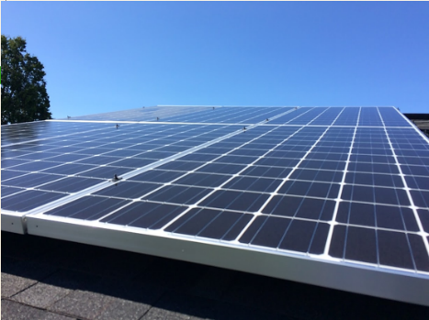
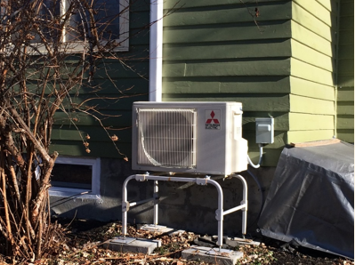
Notes:
Basics of ZEN: weatherization, renewable heating and water heating (heat pumps/wood) and solar PV

Slide 7

Key Program Elements
Building Energy Modeling
ZEN Contractors
Custom Recommendations
Program Implemen-tation
Savings
Guarantee
Financing
Notes:
ZEN is a comprehensive coordinated approach that delivers an customized package of energy improvements to optimize a home’s energy, cost and carbon savings.
Custom Recommendations:
Weatherization
Heat pumps
Wood heating
HPWH
Solar PV
Batteries
EV charging stations
Demand management controls
Contractors Roles:
Subcontractors
Program rebates
Customer communication & coordination
Reporting
Program Implementation
Partnerships
Marketing
Coordination
Management
Reporting

Slide 8

Project Team
Northeast Energy Efficiency Partner- ships
Fiscal Agent
Building Performance Professionals Association
Contractors:
ZEN Projects
Efficiency Vermont
Incentives
Marketing & Outreach
Program Support
VSECU
Home Energy Loan
Marketing & Outreach
Program Support
Montpelier Construction
Building Energy
Reiss Building & Remodeling
Integrated Solar
New Frameworks
New Leaf Design

Slide 9
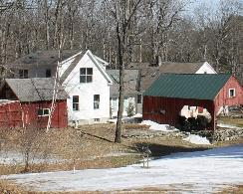
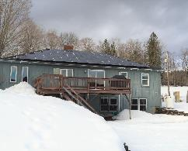
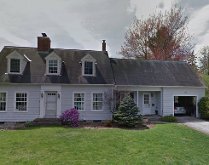
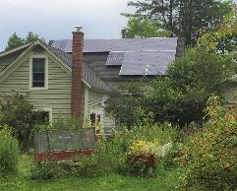
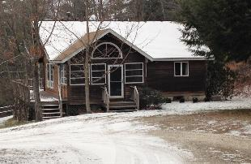
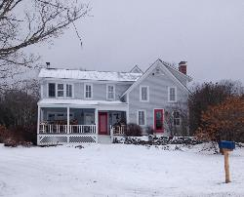
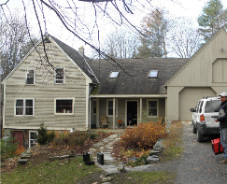
Zero Energy Now Study
35 homes
24 evaluated
Post-improvement
  Fuel and electricity
Customer satisfaction
Notes:
Before we get into the results, I want to ask you to look at a few of the variety of houses that undertook these projects. I think we have some pretty classic examples of Vermont housing stock here.
So, with apologies, I am going to show you a lot of graphs here…

Slide 10


Slide 11

Notes:
Pilot energy and cost savings and cash flow.
This is a real project from the pilot program, a house in Orange County, Vermont.
On the left you see their pre-project energy use measured in MMBtus – at the bottom, fossil fuel, which in this case was mostly oil, but some LP as well. They burned two cords of wood, and used just under 3600 kWh of electricity – all of it from the grid. The total was 120 million Btus, just under 80 of which was fossil and grid.
On the right, you can see that this fuel usage – fossil and grid and even the biomass are radically reduced. How?
First by reducing the load through envelope improvements – insulation and air-sealing. This reduces the load – by almost 20 million Btus – and tightens up the house so that it can be heated with less volatile equipment – namely some combination of heat pumps. Then by installing heat pumps, which maximize heating efficiency – by well over 200%, reducing our effective load by almost 40 million Btus, and, by doing so, we also switch our heating and domestic hot water fuel to electricity, which is renewable ready.
Lastly, we add a solar array which covers more than half the remaining load. Thus a house that was burning almost 80 million Btus of fossil and grid is now using less than 4 million Btus of fossil and grid. Oh, and the cordwood was reduced as well – from two cords to one.
Now, in the middle, we see how driving down our fuel usage also drives down our energy costs – 85% of which disappears altogether. And on the right, we can see how this significant reduced living expense frees up funds to help pay off the cost of the project.
The graph on the right reflects a financing package based on a 20 year long-term home equity loan with a rate of 5 and a quarter percent.

Slide 12

Notes:
Ten projects reduced their fossil usage by 90% or more, and two of those – projects 10 and 23 got rid of their fossil fuel altogether. In nine of the projects, fossil fuel made up less than ten percent of their post-project energy portfolio.
What is particularly exciting as we look across this graph, at these very low post-project fossil fuel figures is the fact that these houses are being heated successfully through the winter with heat pumps. Many of them may have some form of biomass for very cold conditions; some of them are still using fossil fuel as backup, but what we are seeing here is the heat pumps, by and large, are able to heat these homes. This is significant.
A couple of points of irony. Some of you may notice there are two projects that are actually burning more fossil fuel rather than less. What happened here? Well, in the first case – Project 6 – I want to point out how little fossil fuel was being used in the first place. Compare post-project usage here with Project #1 which was reduced – by 85%. The homeowner in #6 told me that the house was so much better insulated that she took advantage of the fact that, when she came home at the end of the day and the fire was very low, a quick blast of the furnace would really heat up the house nicely until the wood stove caught up. I forgave her. Shame on me.
#9 was another story: after she qualified for the program, and received her incentive, the homeowner removed her wood stove and used the heat pump largely to replace the three cords of wood she had been burning, instead of displacing her fossil fuel as the modeling had anticipated. This is a hazard of handing out incentives based on modeling.

Slide 13
Notes:
Now we can move on and see how we fared across the 24 projects we looked at from the pilots:
First, with regard to energy savings, we have the same breakdown as in the previous graph, except that renewable energy – electric and biomass – are combined into one, and fossil and grid electric are combined into one. Which is why you will see quite a bit of renewable energy in the pre-project energy use: it’s mostly biomass.
You see very much the same pairings of energy usage as in the graph from the slide before – high pre-project fossil and grid-sourced electric on the left… being sharply driven downward – first by envelope efficiency improvements, and then by the superefficient mechanical upgrades, and finally by the installation of renewable electric generation to cover substantial parts of the load.
Note in particular, Projects 2, 3, 6, 10,17,18,19, and 35. Note also that while the formula is the same, the proportions vary significantly. Some projects had dramatic envelope savings (#s 16, 21, and25), while others focused much more on renewables (#3, 32, 33, and 35). Note also projects 6 and 18, which show substantial renewable before and after. In both of these cases, cord wood was a substantial part of their mix to start with, and remained so afterwards, but was also reduced by 25 to 50% with the help of the heat pumps.

Slide 14

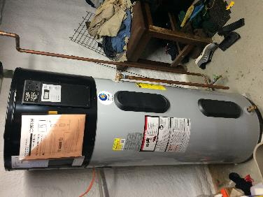
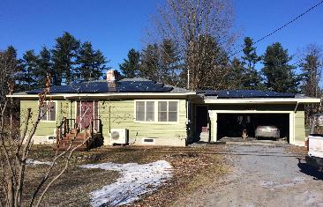
Ranch, 1336 sq ft
Gross Project Cost: $56,612
Net Project Cost: $43,209
8 kW solar array
Heat pump water heater
Mini-split heat pumps
Attic and basement insulation and air seal
 | Pre-Project | Post-Project
Fossil & Grid MMBtu | 92.35 | 41.69
Annual Energy Costs | $1,846 | $258
 | Projected | Actual
F&G savings | 81% | 54%
Notes:
This is an older home project…Vintage 1957. Small ranch. These folks were close to retirement and came to an energy committee meeting with the intent to make significant changes to their home so they could age in place, be comfortable and finally be efficient. They started with detailed energy audit. She is an accountant/analyst which helped drive the cost effectiveness of the project
These guys really wanted to work with a single contractor able to do all the pieces of the project.
Added an electric car and additional solar 1 year later

Slide 15

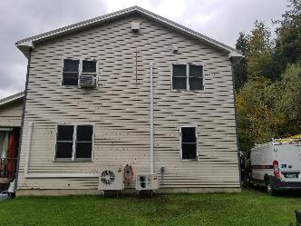
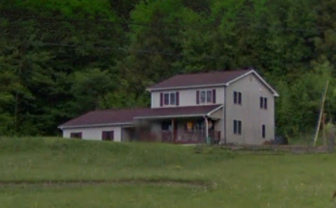
Colonial, 1832 sq ft
Gross Project Cost: $ 37,474
Net Project Cost: $ 23,925
6.4 kW solar array
Heat pump water heater
Mini-split heat pumps
Attic and basement insulation and air seal
 | Pre-Project | Post-Project
Fossil & Grid MMBtu | 49.07 | 4.52
Annual Energy Costs | $2,718 | $993
 | Projected | Actual
F&G savings | 75% | 98%
Notes:
A typical suburban home with atypical homeowners! This project started with an energy audit as the homeowners were too hot upstairs in the summers and wanted to explore electrification. Heavy wood heat users. Replaced their roof when they decided to install solar…solar done by Suncommon was under contract when we hit the project.
They just recently added another heatpump as they were still hot upstairs in the summer after insulation and airsealing of the attic
In this case a large portion of the renewable energy is wood burning.

Slide 16
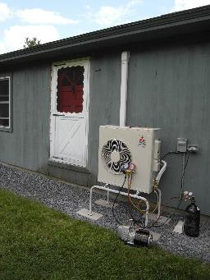
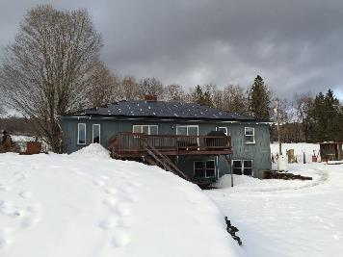
Ranch, 1688 sq ft
Gross Project Cost: $26,635
Net Project Cost: $16,143
7.8 kW solar array
Heat pump water heater
Mini-split heat pump
 | Pre-Project | Post-Project
Fossil & Grid MMBtu | 78.57 | 3.75
Annual Energy Costs | $2,430 | $387
 | Projected | Actual
F&G savings | 93% | 95%
Notes:
This one is a family home and has had heavy improvements over the last few years. The owner is one of our senior energy auditors allowing for great decision making and employee discounts coupled with DIY potential to help the bottom line and financial outcomes
Added a Tesla battery through GMP program…it performed well in recent outages
These folks replaced their roof when they decided to install solar
In the process of adding another heatpump now

Slide 17
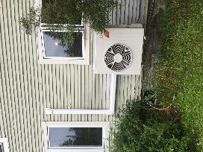
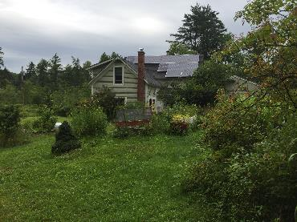
Farmhouse, 1908 sq ft
Gross Project Cost: $34,549
Net Project Cost: $26,499
4.6 kW solar array
Mini-split heat pump
Pellet stove
Attic and basement insulation and air seal
 | Pre-Project | Post-Project
Fossil & Grid MMBtu | 87.89 | 10.96
Annual Energy Costs | $4,538 | $653
 | Projected | Actual
F&G savings | 66% | 87%
Notes:
This was another on of our phased projects…this phase being solar, heatpump and more insulation.
This one could have used more solar and a more comprehensive plan for the phase. This solar system under performed in 2018 and in 2019 from our projections

Slide 18

Lessons Learned
We can achieve deep (60%+) energy savings in existing homes with available weatherization, heat pump and solar PV technologies
By optimizing a custom package, we can delivery up to 100% savings in regular existing homes
Energy savings can pay for these improvements with financing
We need to break down program rules, regulations and silos to offer customers what they want: energy efficiency AND renewables
“True believers” will pay to get off fossil fuels, even if not cost-effective
Contractors much prefer larger integrated packages with larger profit opportunities to smaller weatherization-only offerings

Slide 19
Vision for Success
2020
  Zero Energy Now developed and launched
  Up to $20,000 in financial incentives available for successful projects
  10 projects enrolled!
2021 Goals
  Partnerships and funding secured for Vermont
  Complete 20 Vermont projects
  Explore “Total Energy Pathways” expansion into other states with NEEP
2022+
  Double participation annually in Vermont
  Secure TEP interest and partnerships in other states

Slide 20
Zero Energy Now Committee
Richard Faesy, Energy Futures Group (rfaesy@energyfuturesgroup.com)
Malcolm Gray, Montpelier Construction (malcolm@montpelierconstruction.com)
Derek Koundakjian, Northeast Energy Efficiency Partnerships (dkoundakjian@NEEP.org)
Tom Perry, New Leaf Design (newleafdesign@gmavt.net)
Chuck Reiss, Reiss Building and Remodeling (vbrreiss@gmavt.net)
Matt Sharpe, Efficiency Vermont (msharpe@veic.org)
Gabrielle Stebbins, Energy Futures Group (gstebbins@energyfuturesgroup.com)

Slide 21
Interested in Zero Energy Now?
Please contact us for more information:
Gabrielle Stebbins, Energy Futures Group (gstebbins@energyfuturesgroup.com)
802-825-9515

